Slide 1
Amazon Sales Analysis in India Data Science Project
Mohamed Siraj - 239338U

Slide 2
Introduction
India is the largest country having high competition market for the dresses into ecommerce field and the target of the team is to increase the sales of Amazon India than the previous year.
The main factor is to analyze the sales by state and region and finding a best way to improve it
I am Performing as a Data scientist role to generate the report to present the executive team to support to increase the sales of the amazon india

Slide 3
Dataset Information
Dataset Name: Amazon Sales Report in India
Dataset Owner: Amazon E-commerce company (The Devastator).
Dataset Records Duration: 30th of April 2022 to 31st of May 2022
Dataset Attributes count: 17
Dataset Total Records Count: 73830
Beneficiary from your outcome: Executive Management of Amazon and Sales Team.
Dataset Resource Url: https://www.kaggle.com/datasets/thedevastator/unlock-profitswith-e-commerce-sales-data?select=Amazon+Sale+Report.csv

Slide 4
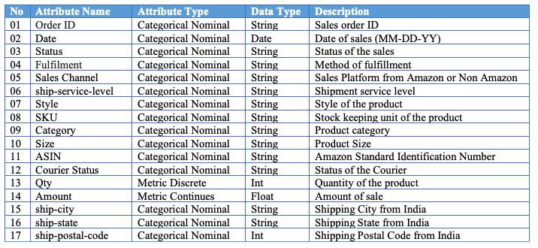
Dataset Information

Slide 5
Amazon Dress Sales Analysis - India
Mohamed Siraj
Data scientist

Slide 6
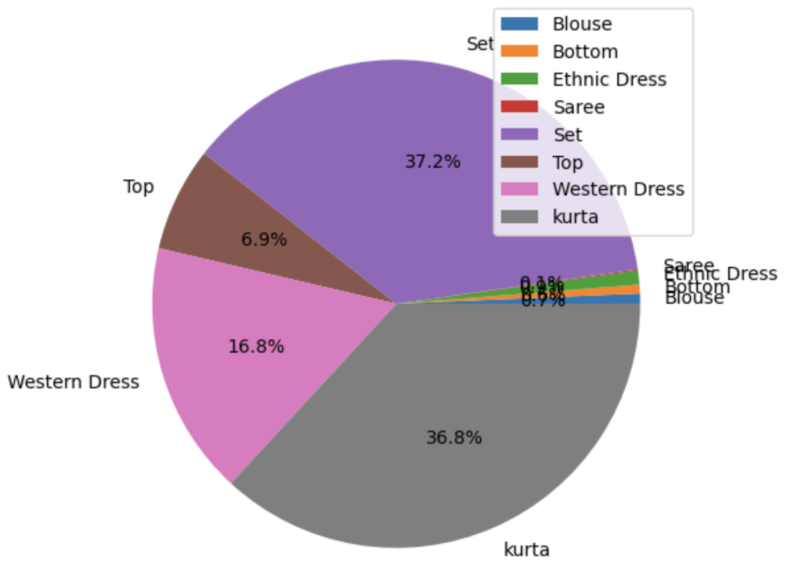
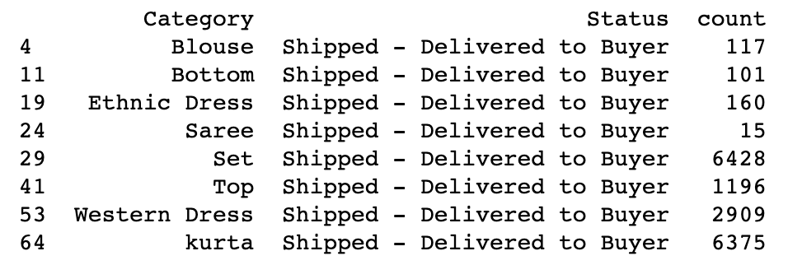
Which category of dresses sells most in India by 2022?

Slide 7
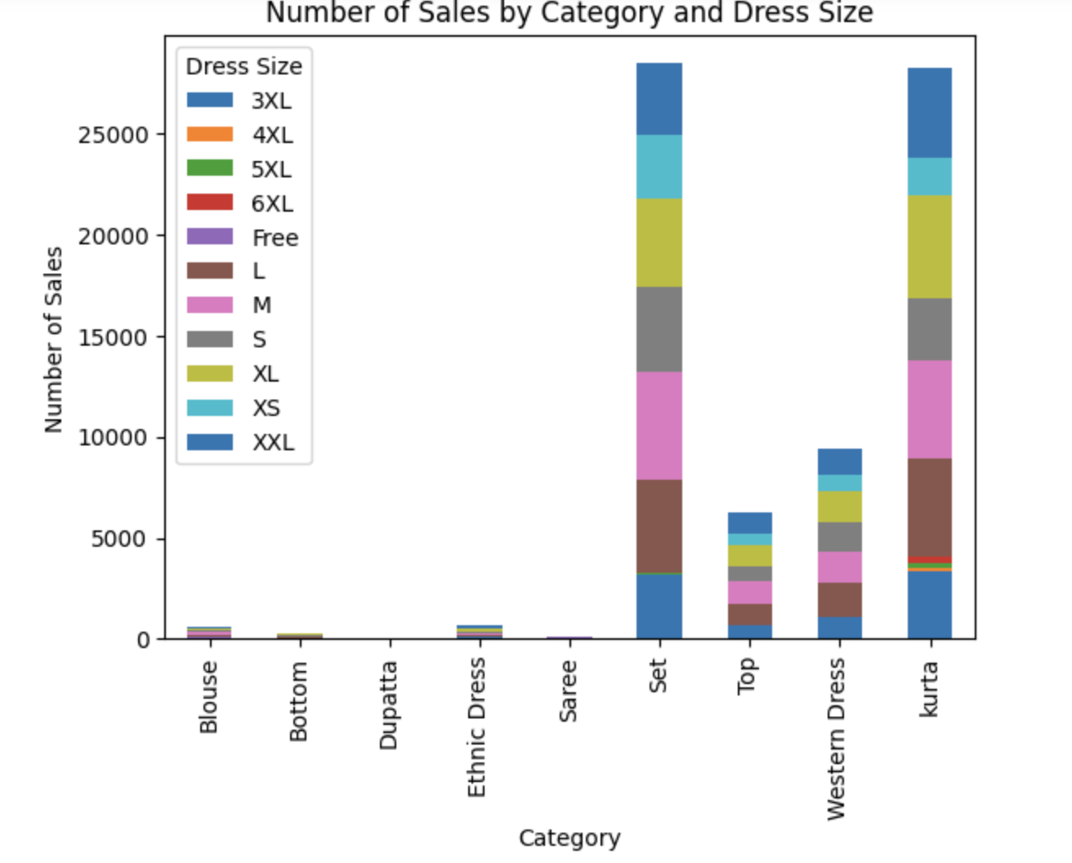
Which size of dresses sells most by category?

Slide 8
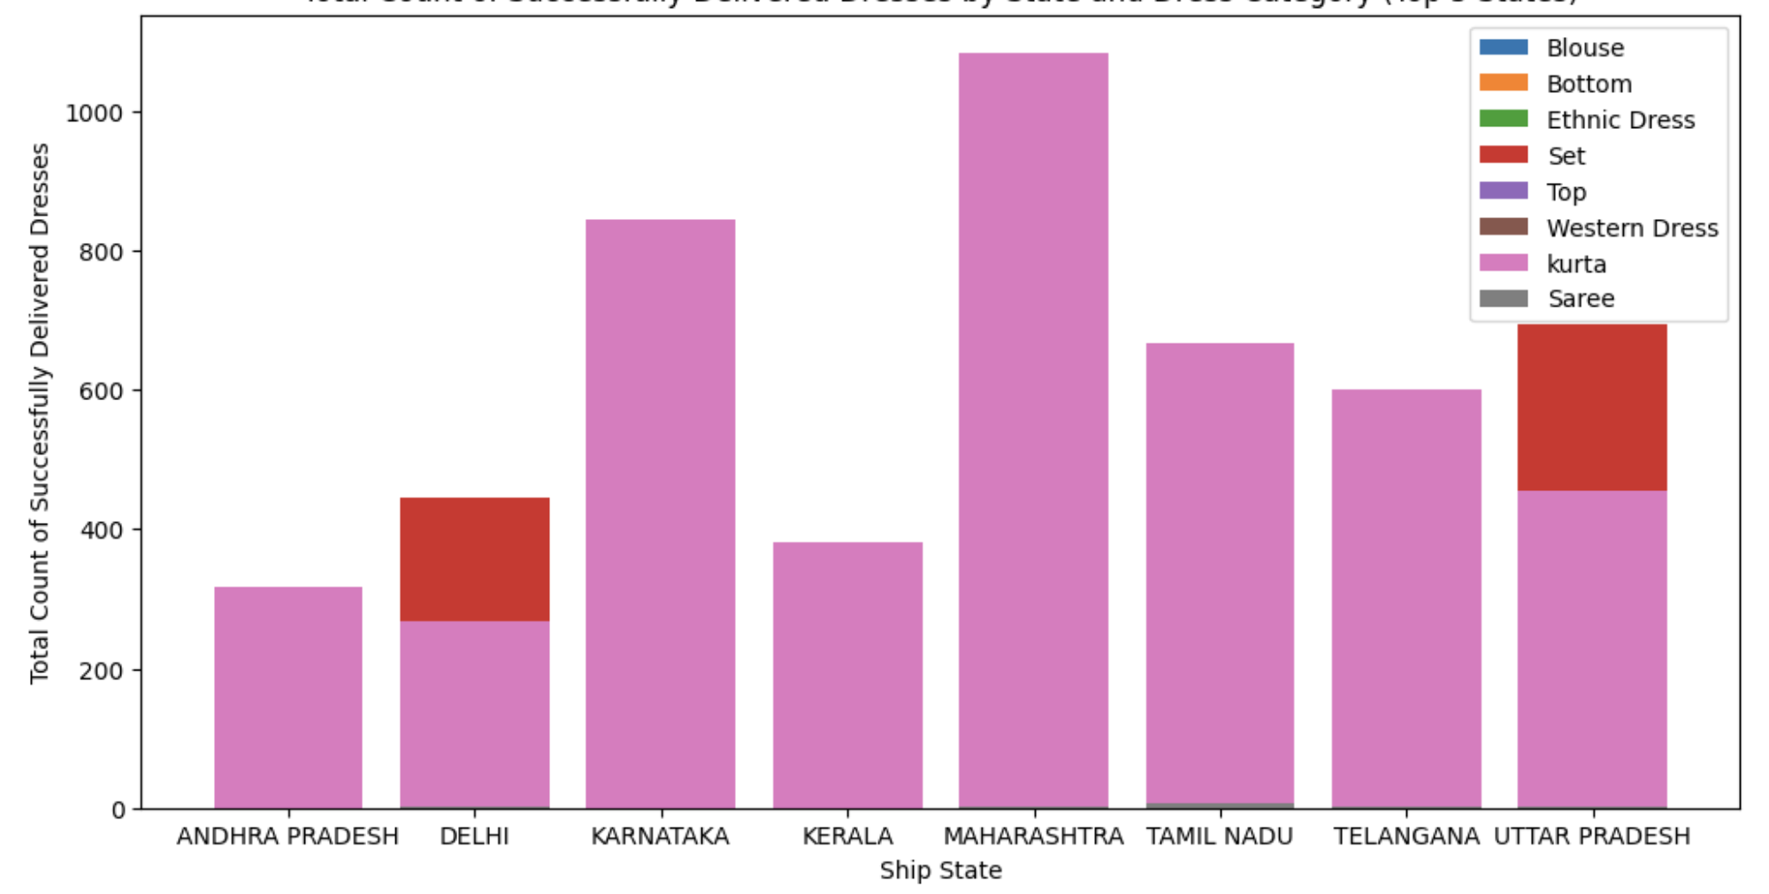
What are the states buys more Product in India ?

Slide 9
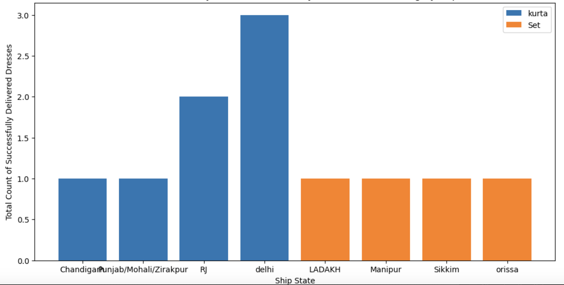
What are the states buys low Product in India ?

Slide 10
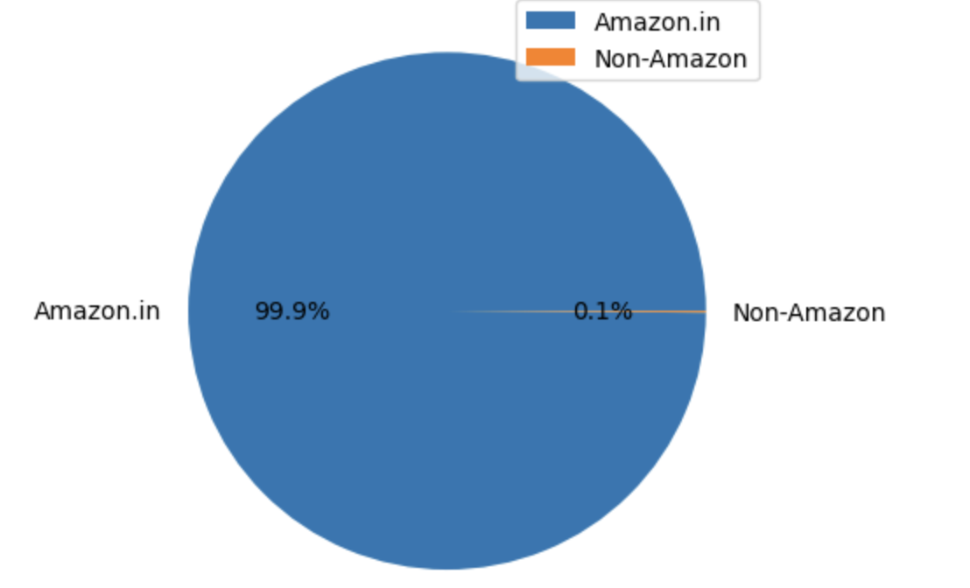
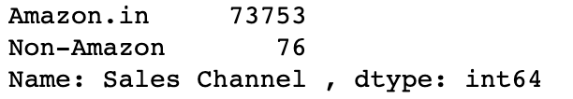
What are the sales channel used in Sales?

Slide 11
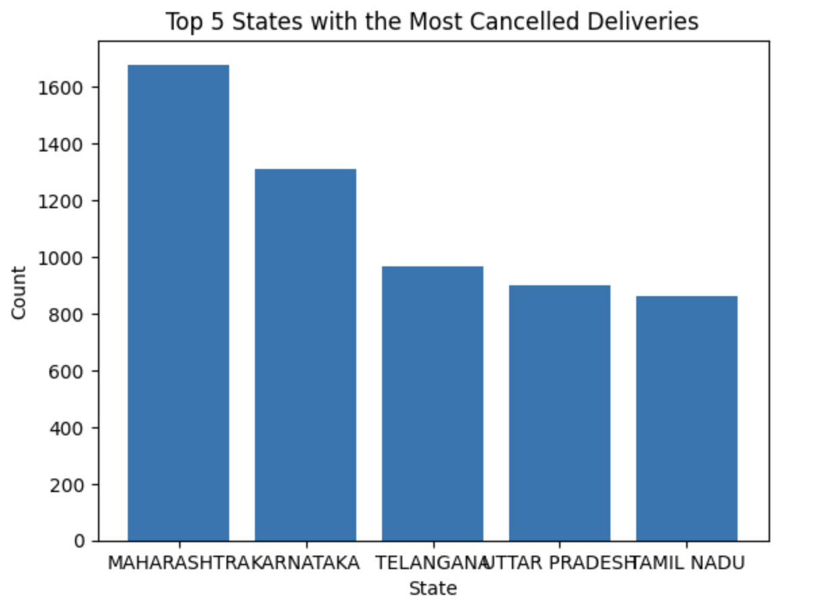
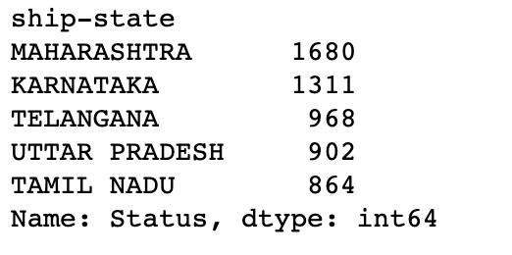
What are the most cancelled states in India?

Slide 12
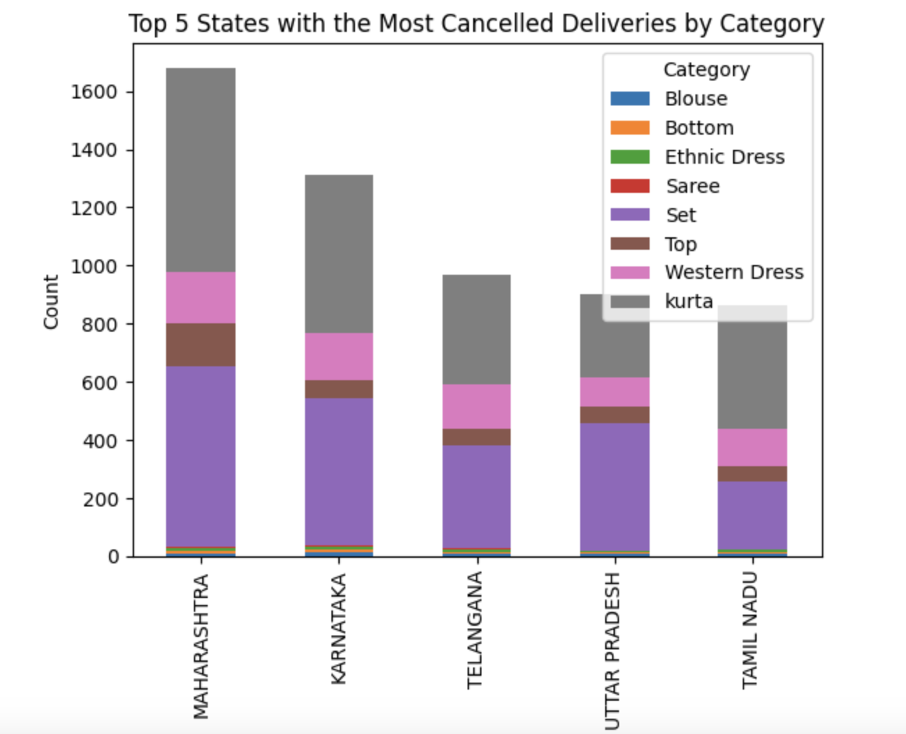
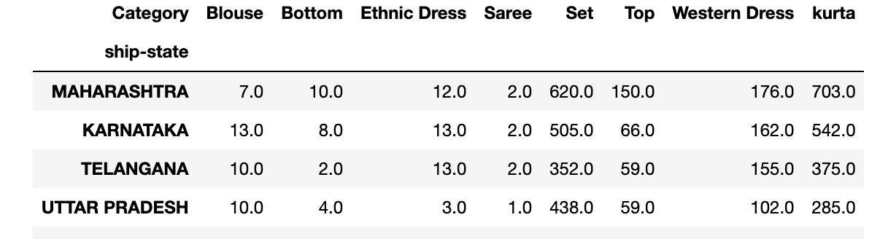
What are the most cancelled Categories in India?

Slide 13
Conclusion

